Slide 1
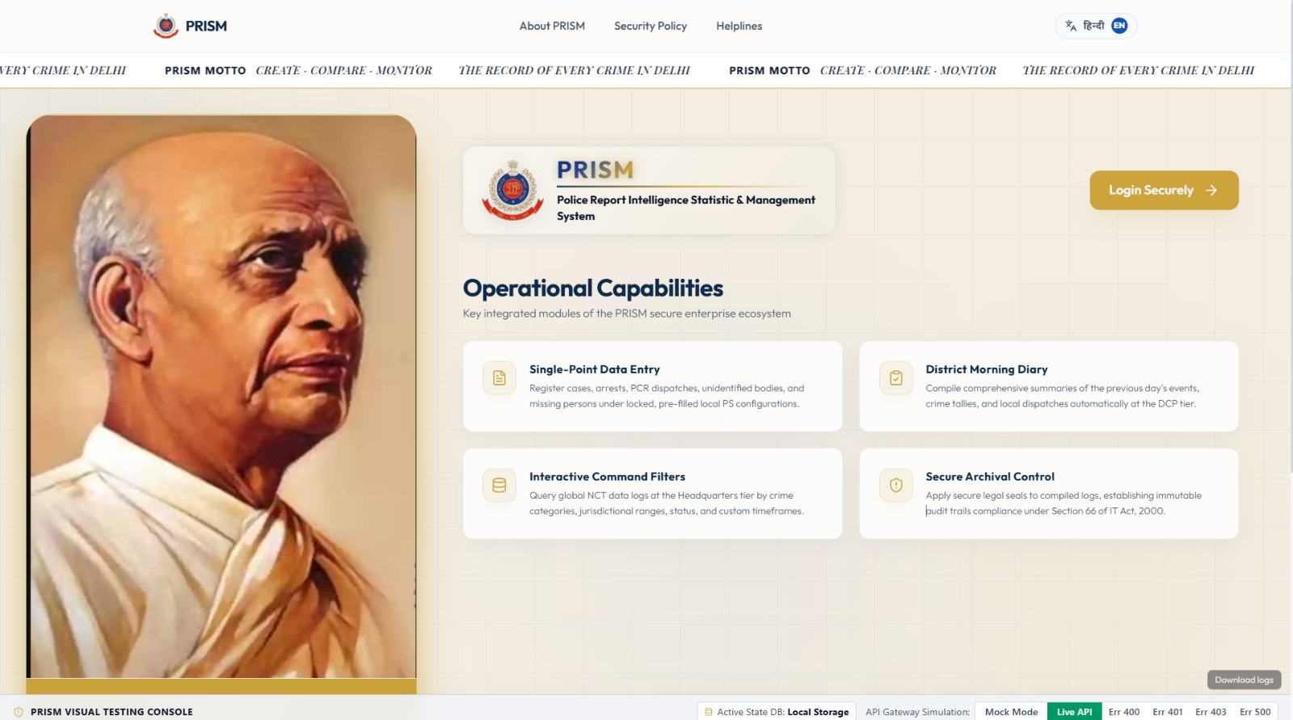

Slide 2
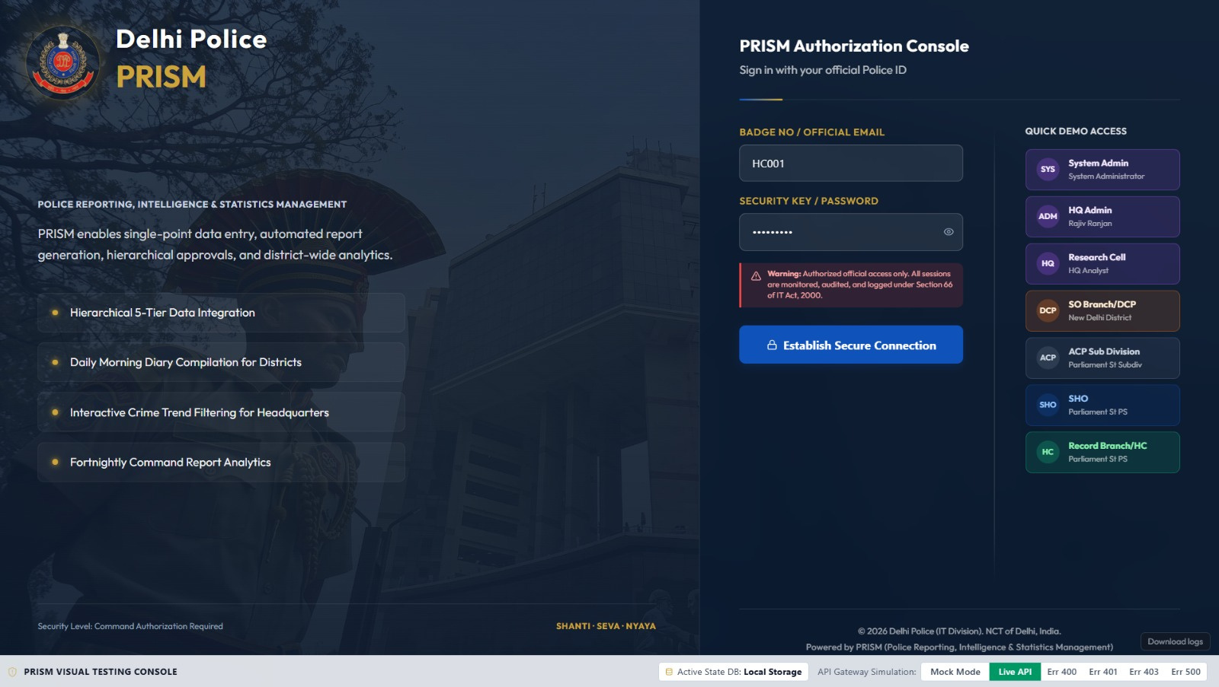
07 | Detailed Results
08 | Trend Results
09 | Discussion of Findings
10 | Implications and Recommendations
11 | Conclusion
12 | Q&A
2

Slide 3
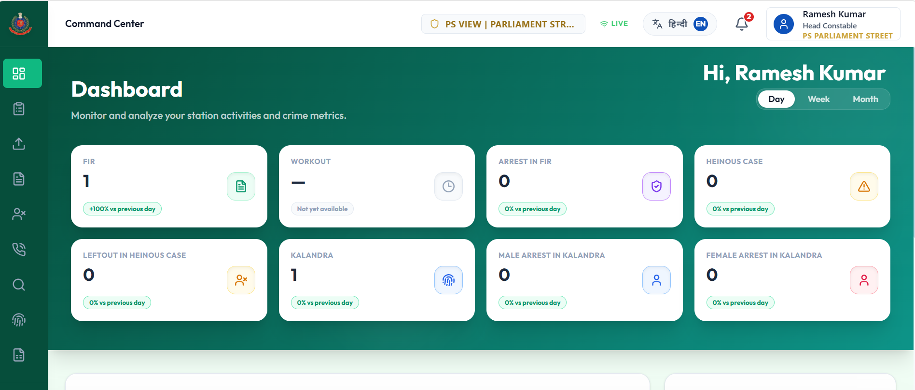
HC Dashboard
3

Slide 4
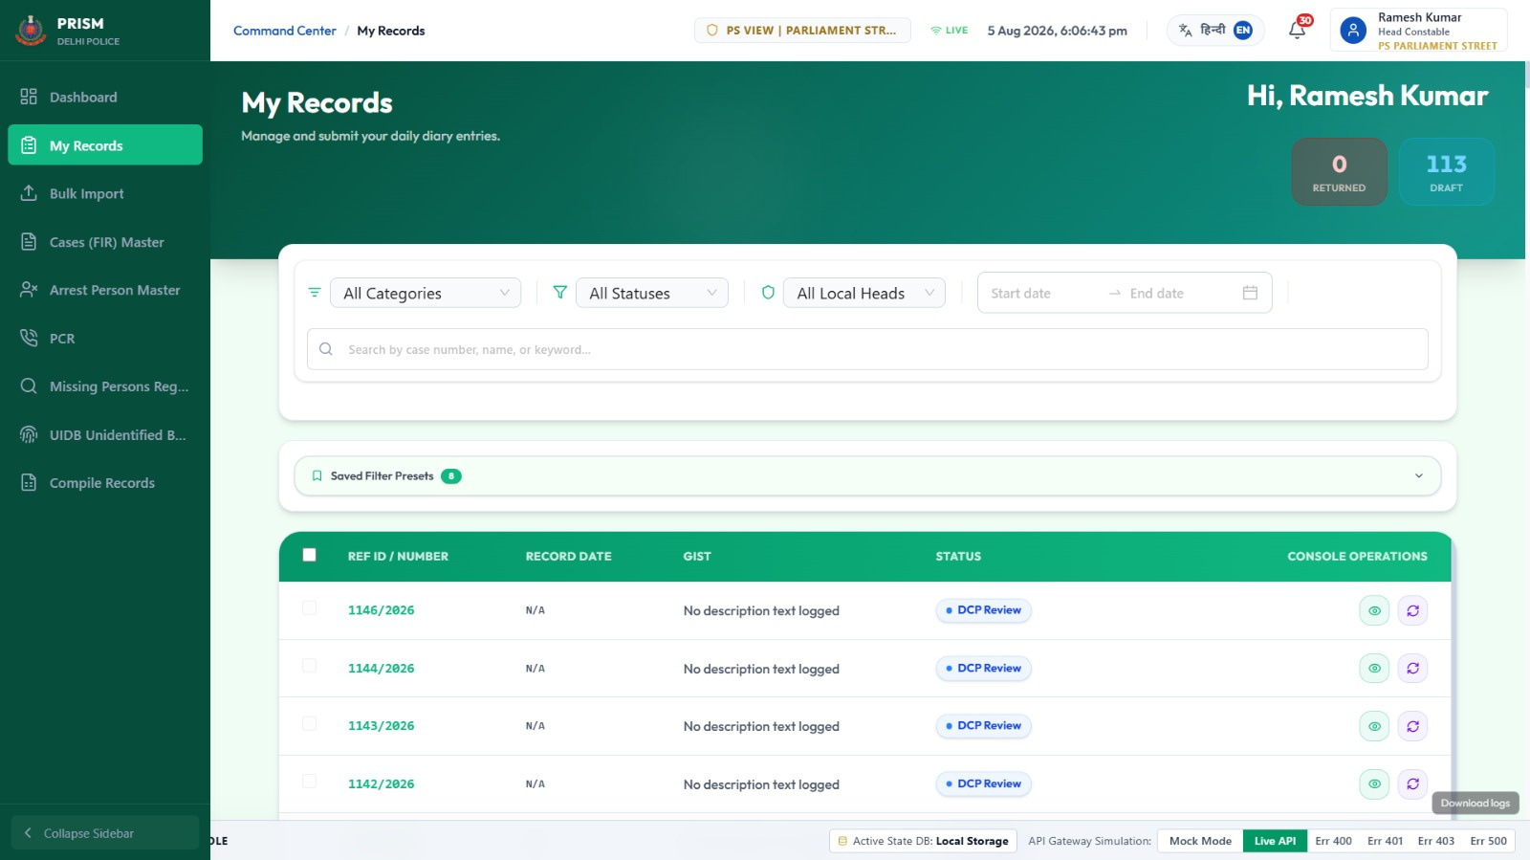
4

Slide 5
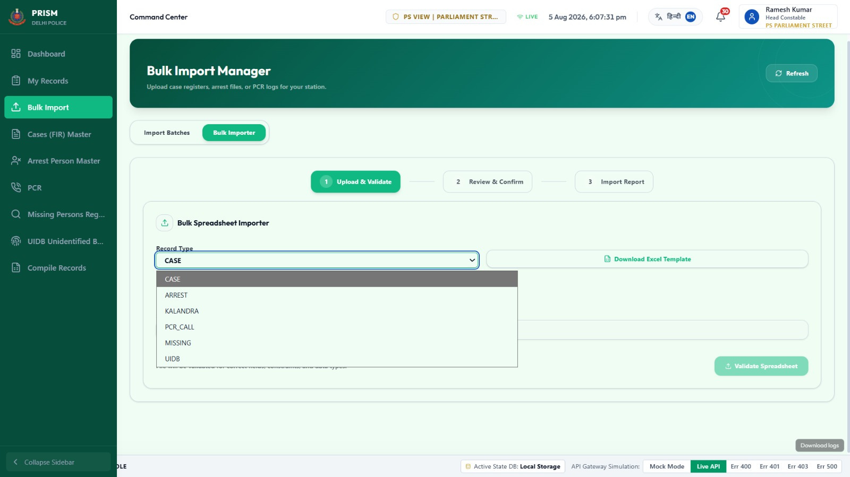

Slide 6
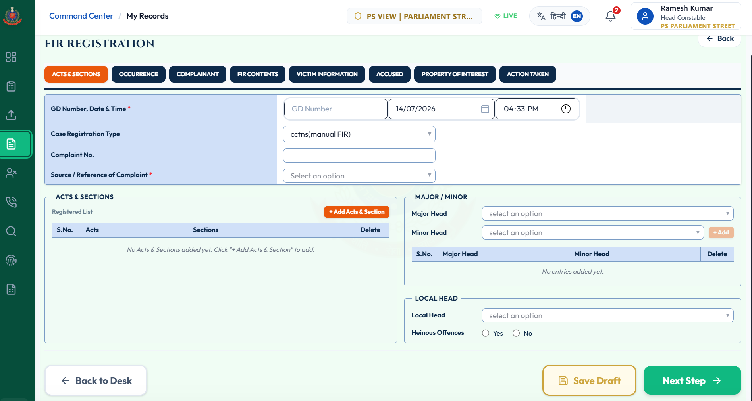
CASE(FIR)

Slide 7
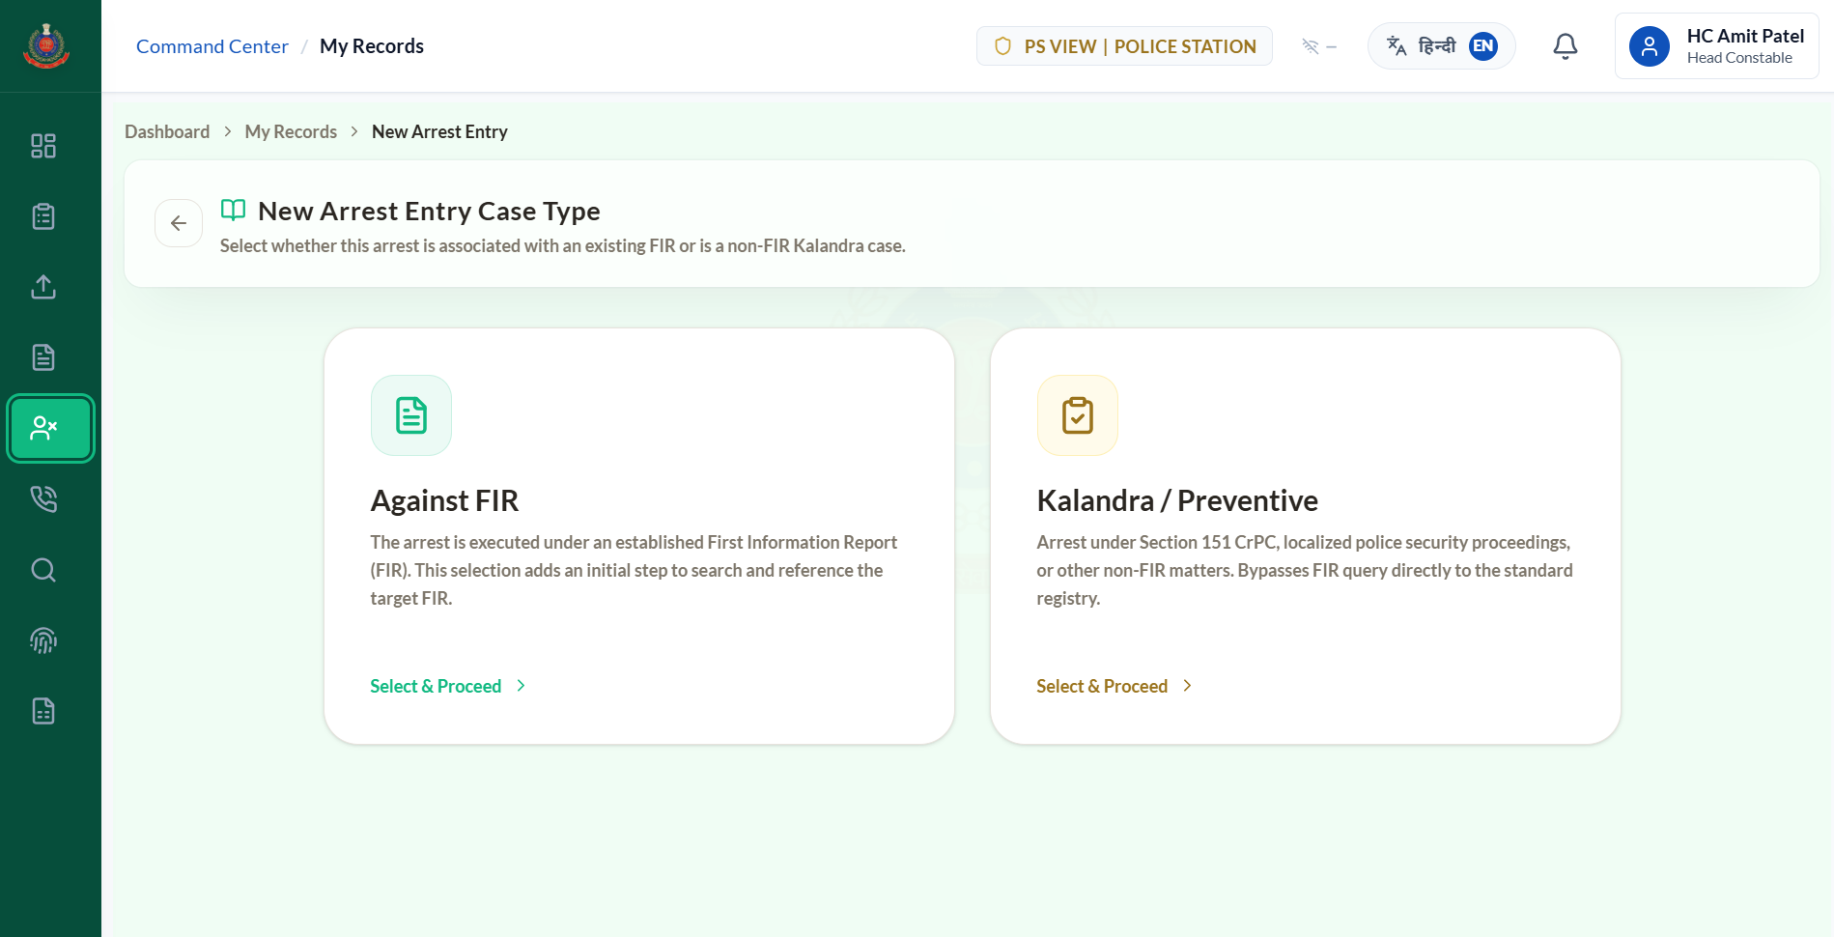

Slide 8
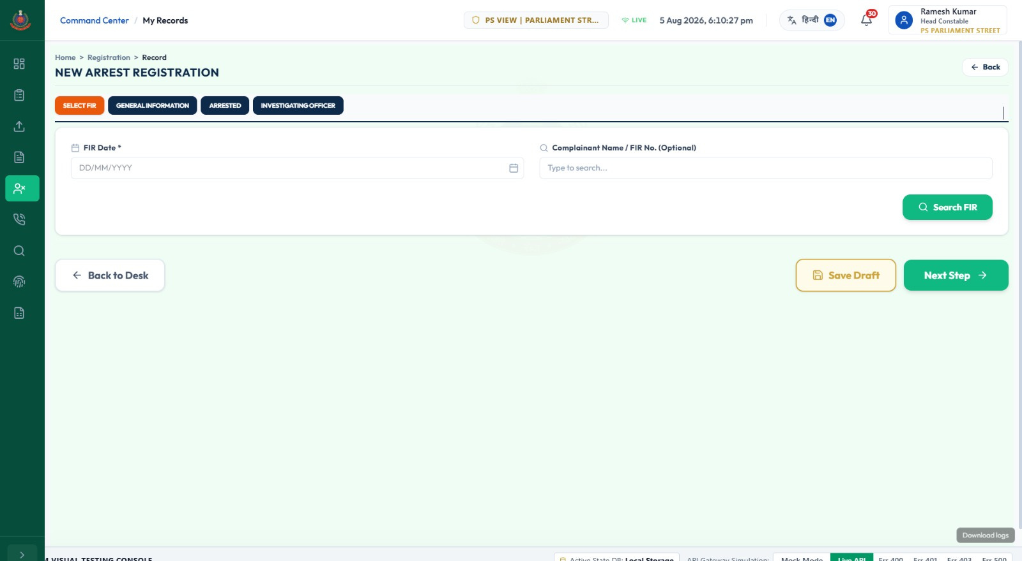
ARREST AGAINST FIR

Slide 9
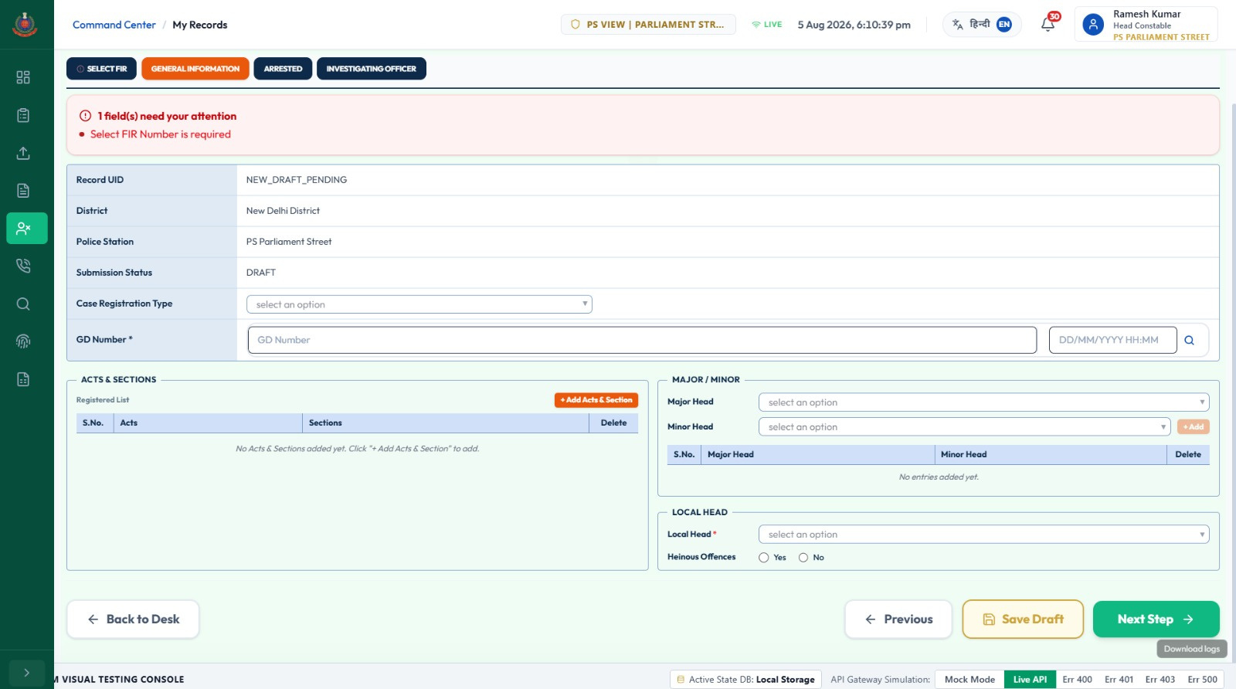

Slide 10
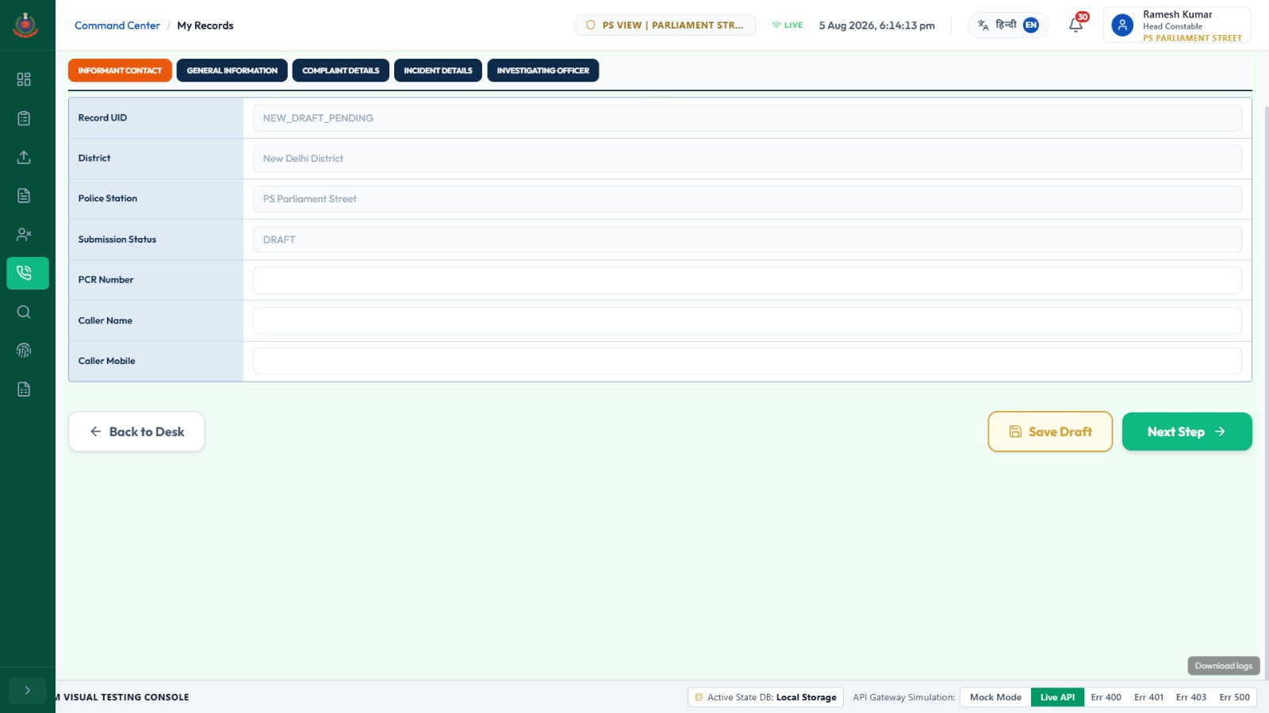
PCR CALL

Slide 11
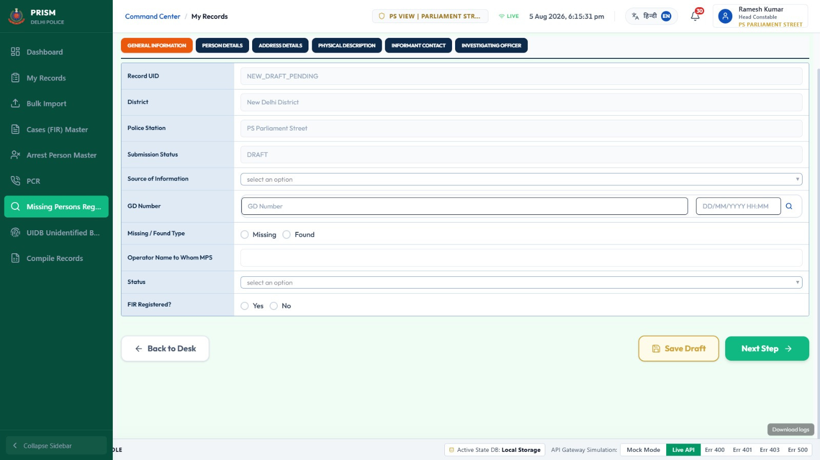
MISSING

Slide 12
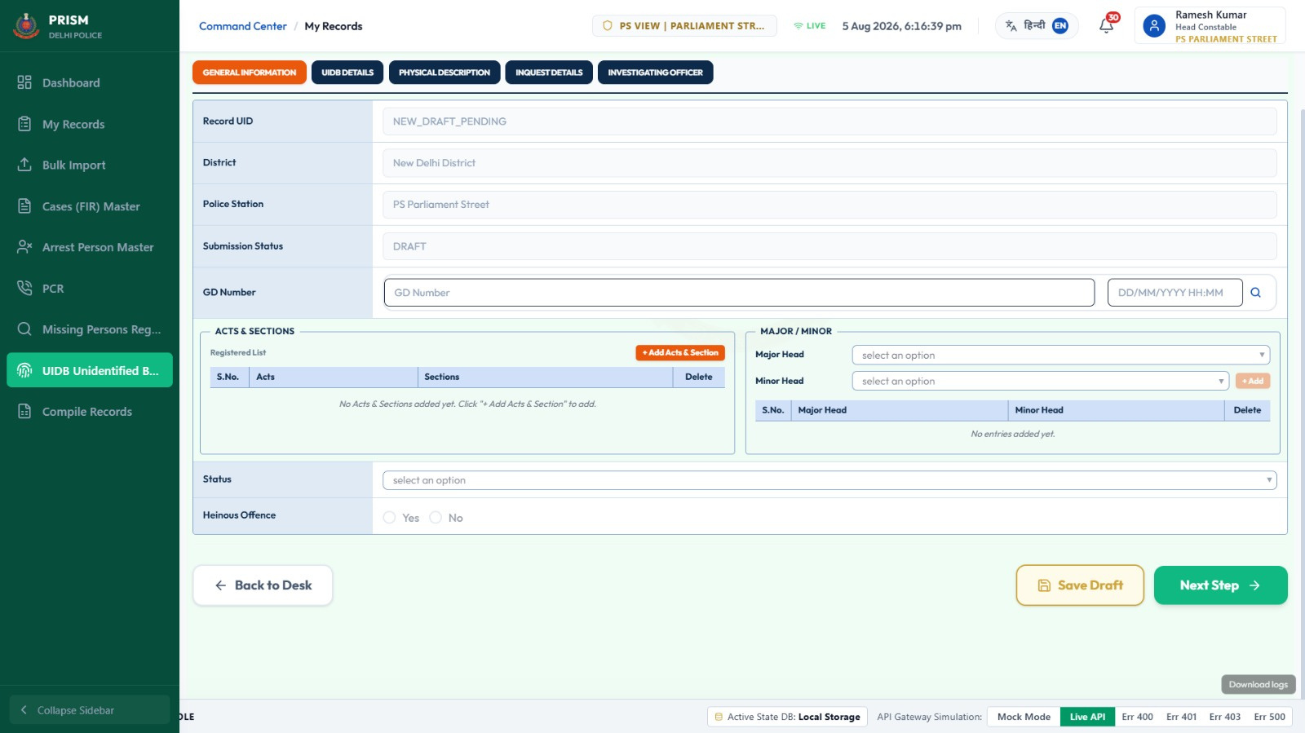
UIDB

Slide 13
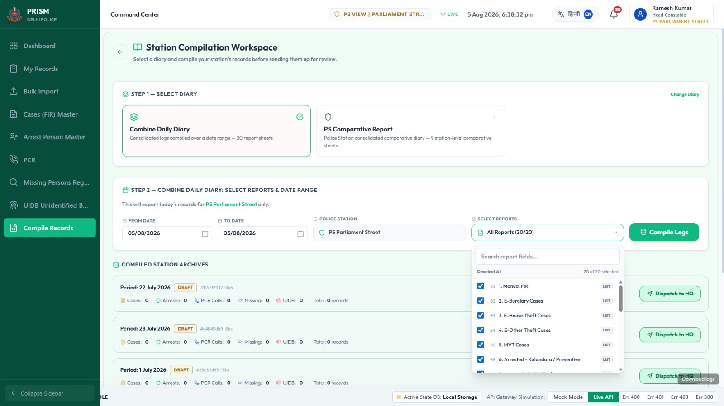

Slide 14
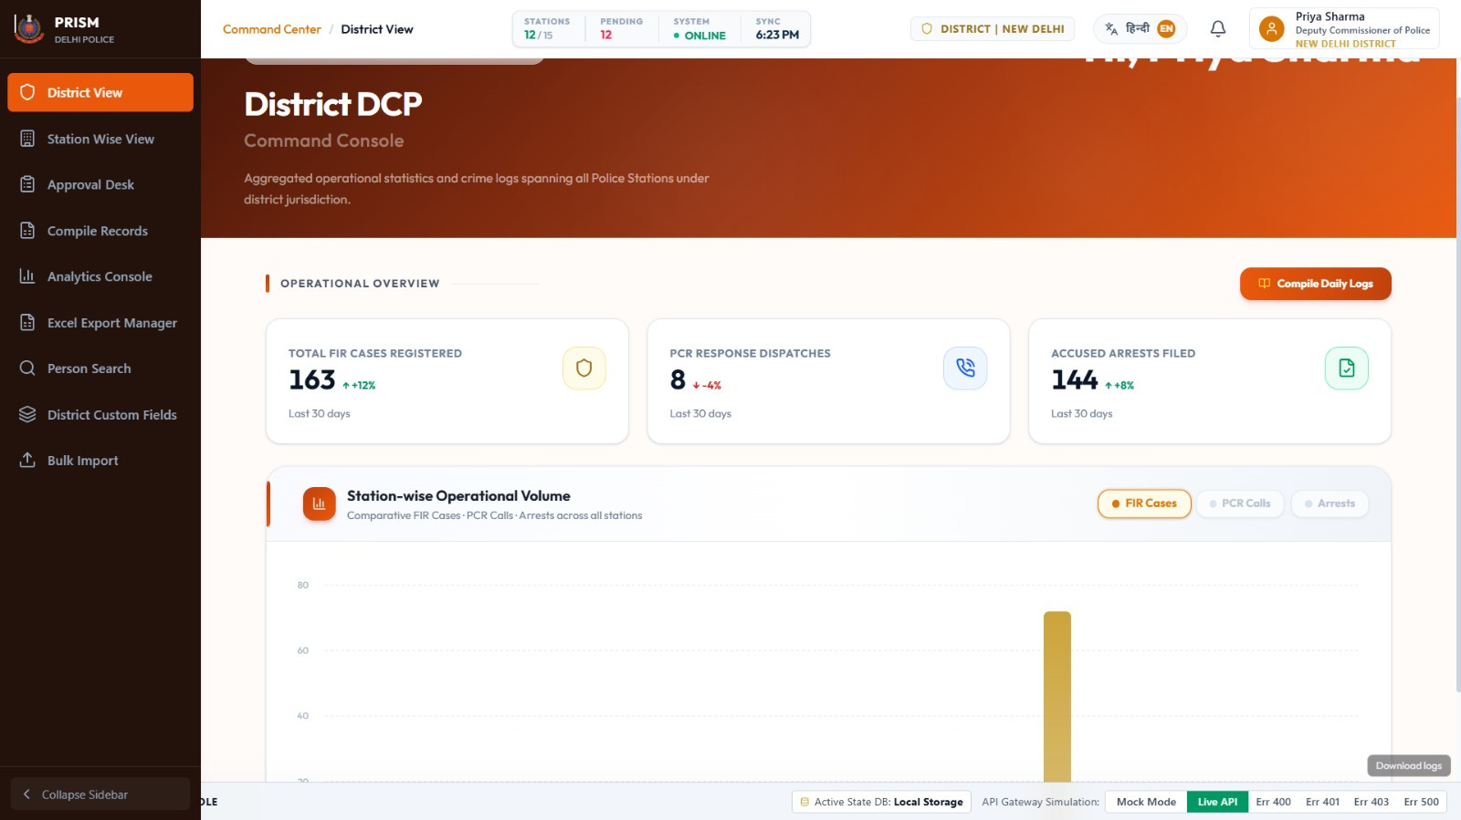
DCP CONSOLE
14

Slide 15
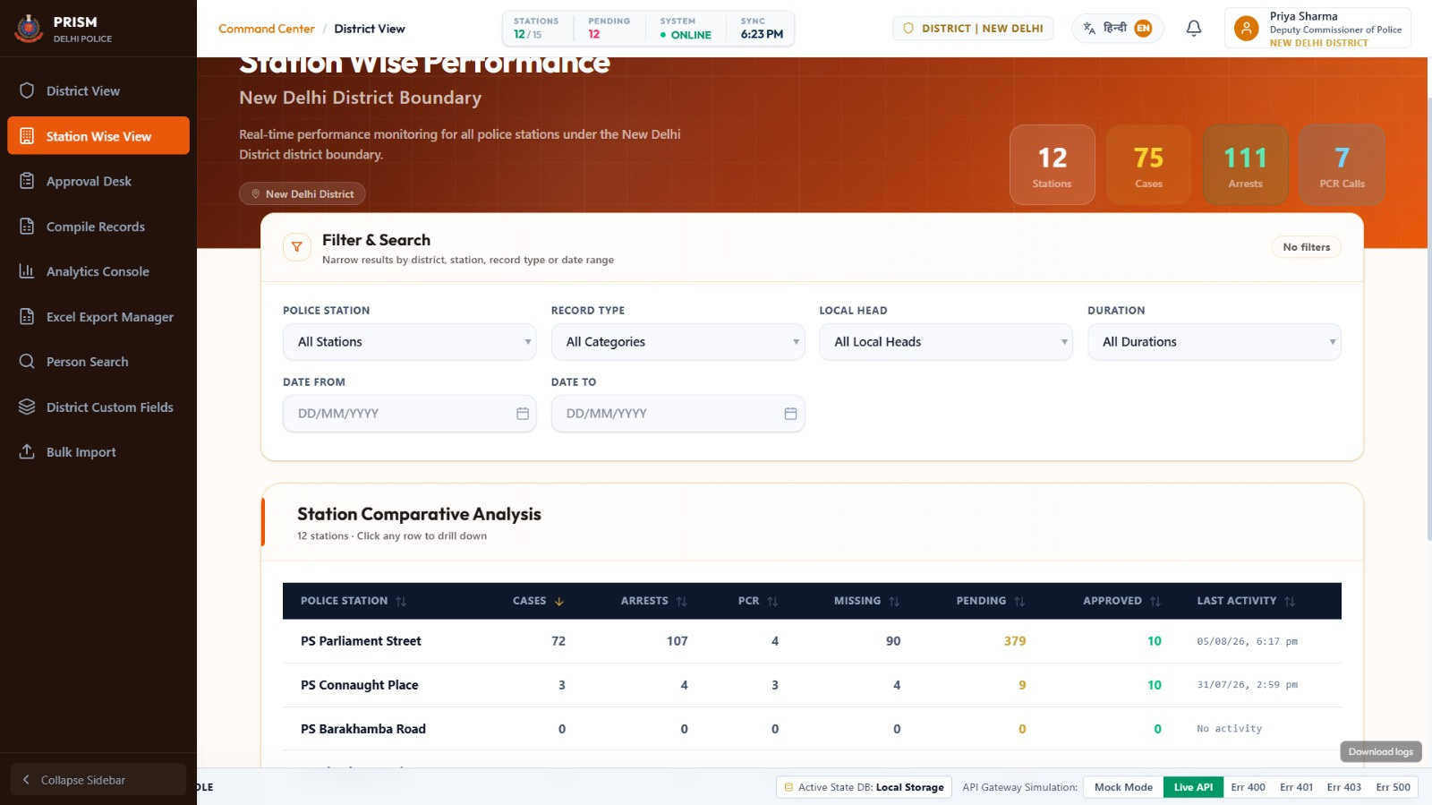

Slide 16
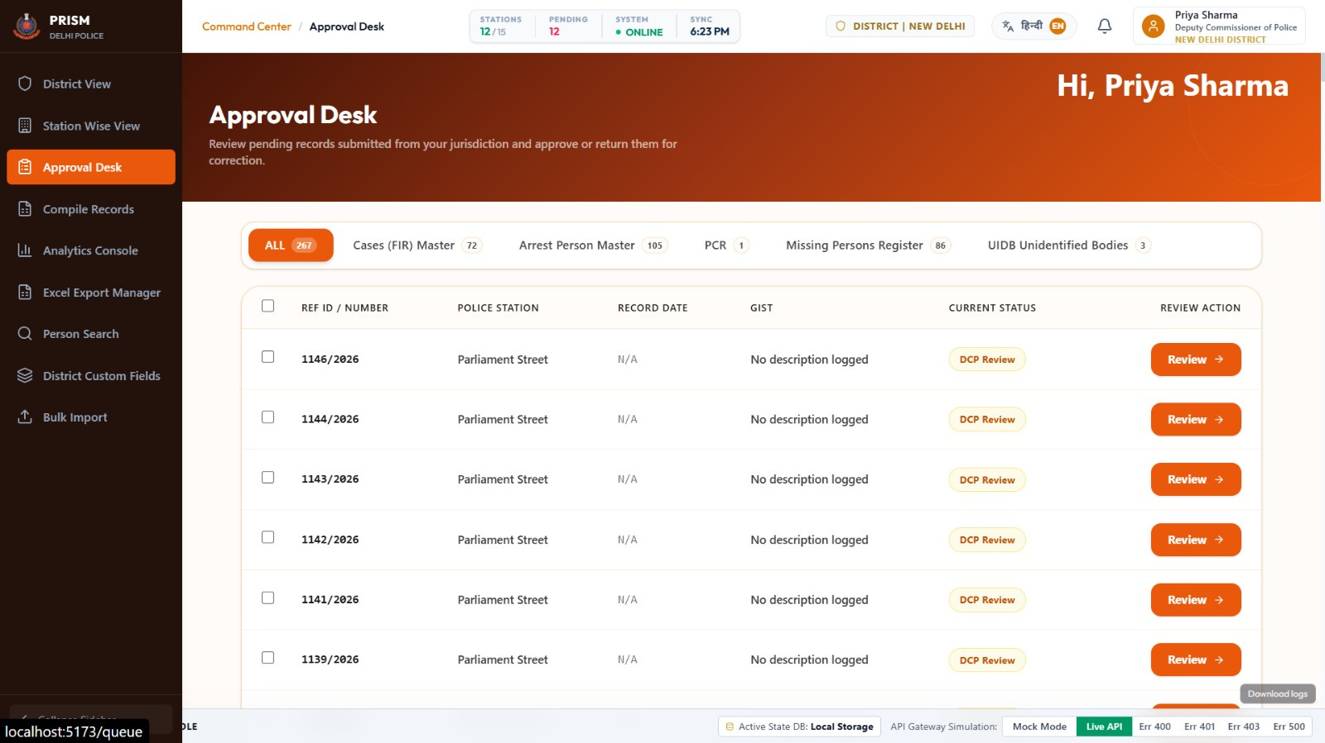

Slide 17
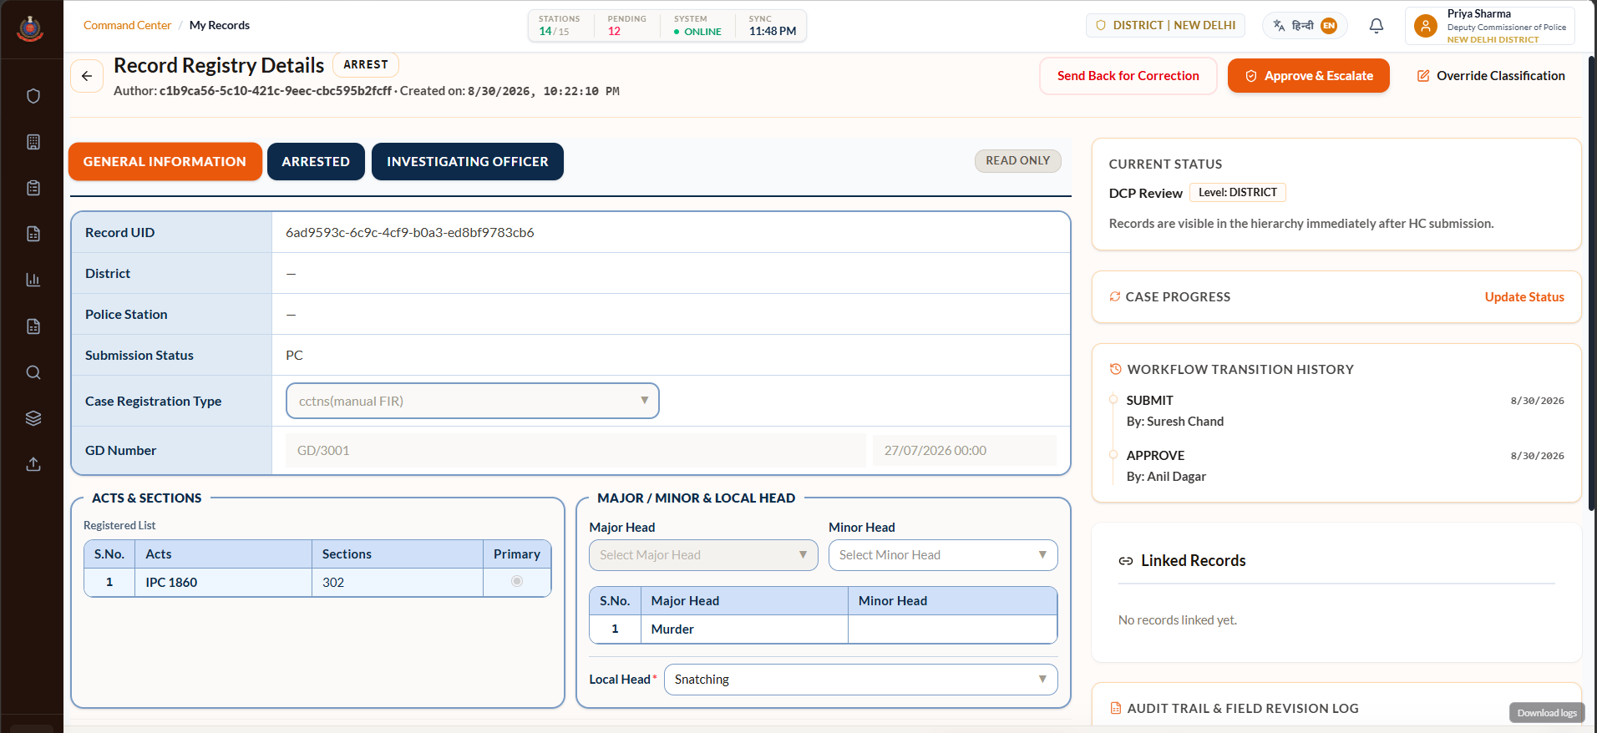

Slide 18
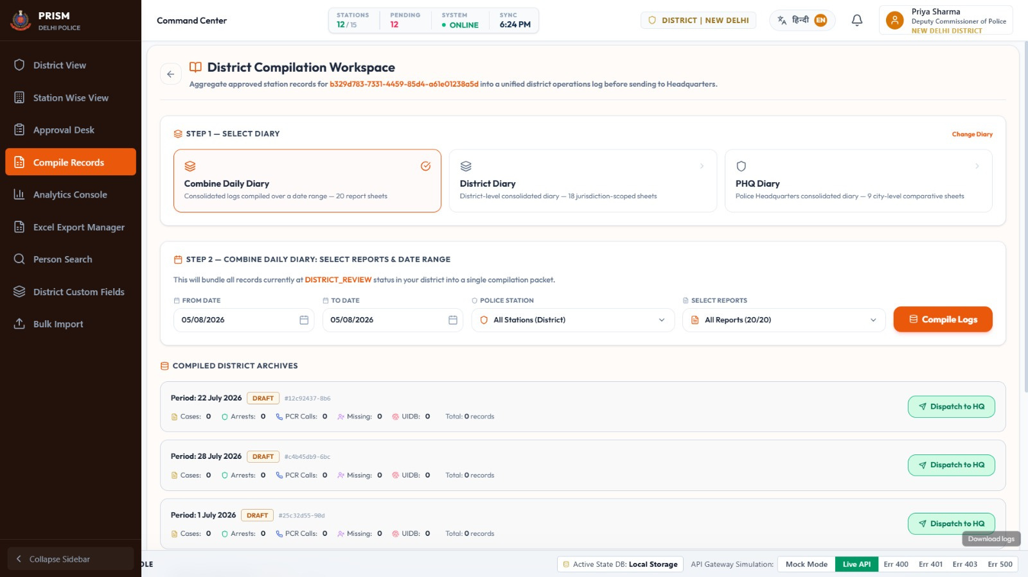

Slide 19
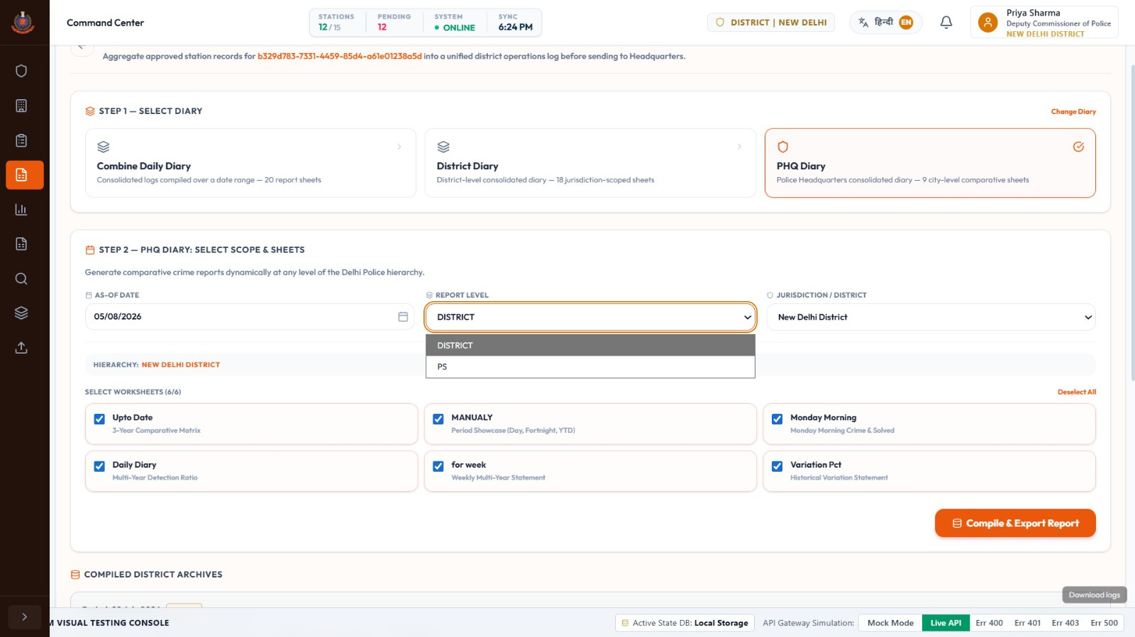

Slide 20
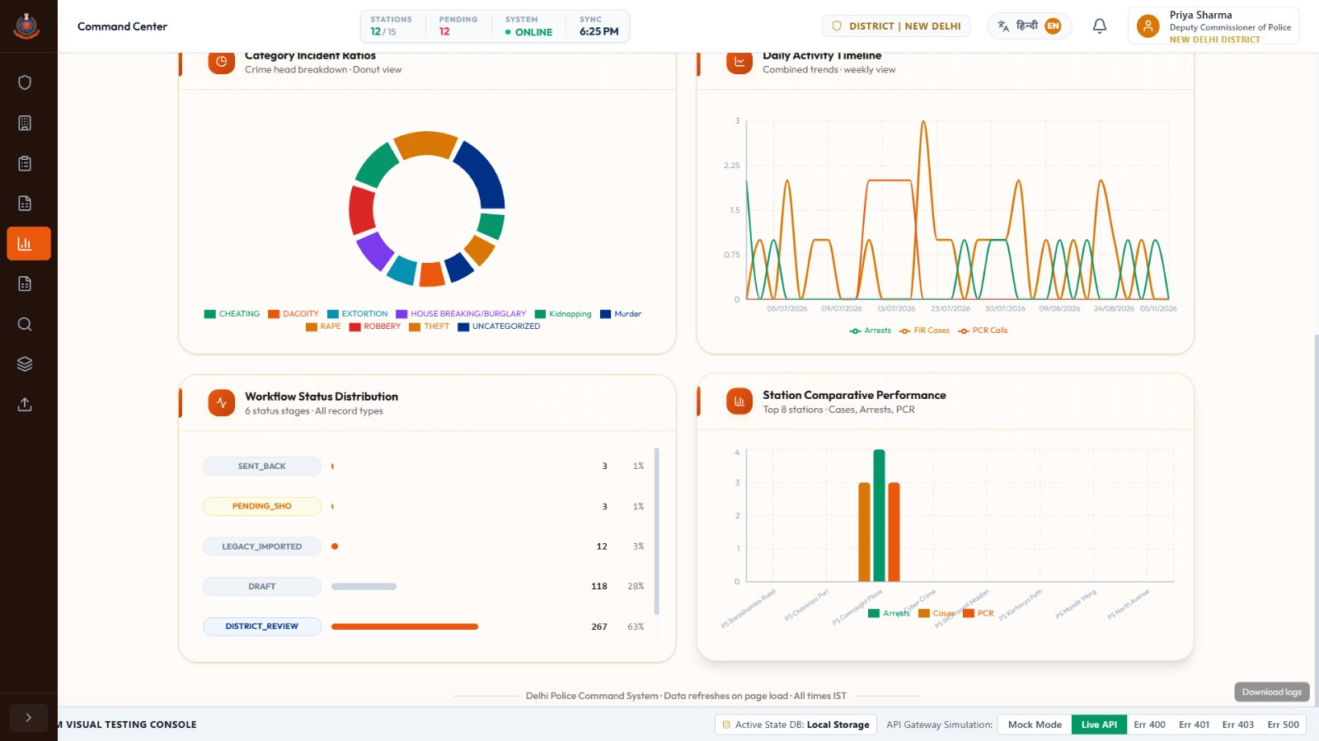

Slide 21
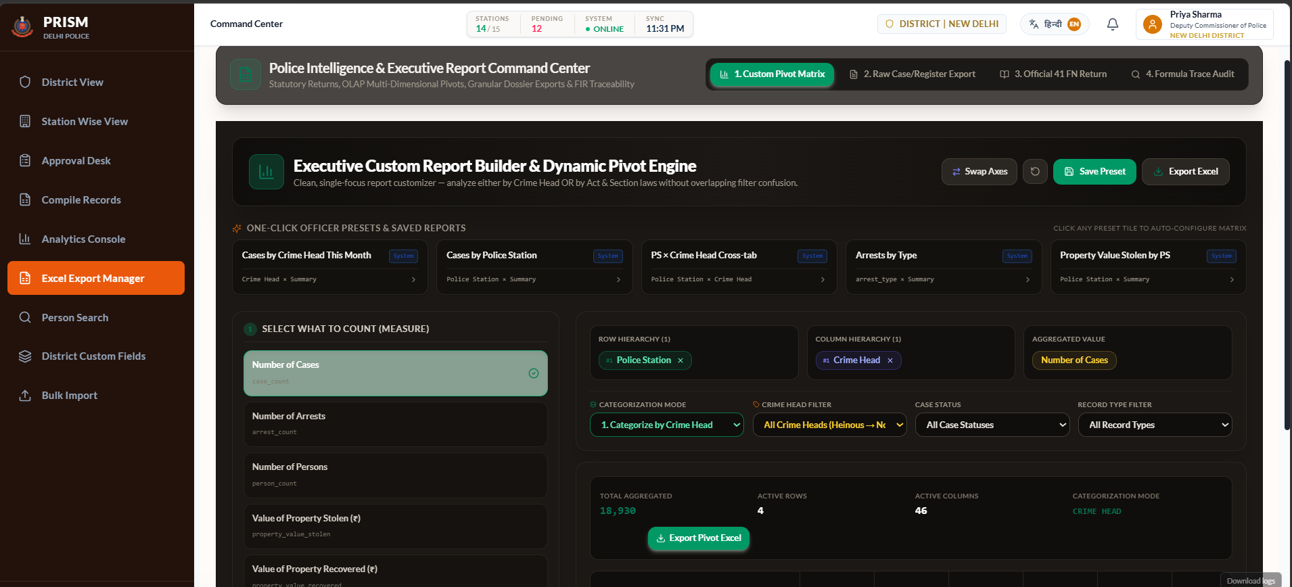

Slide 22
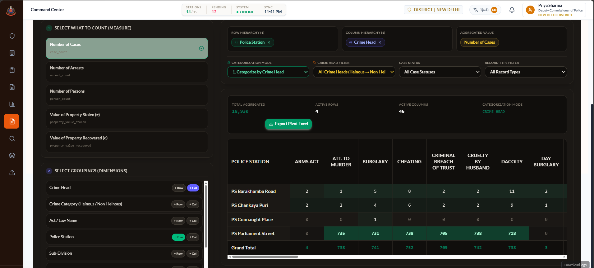

Slide 23
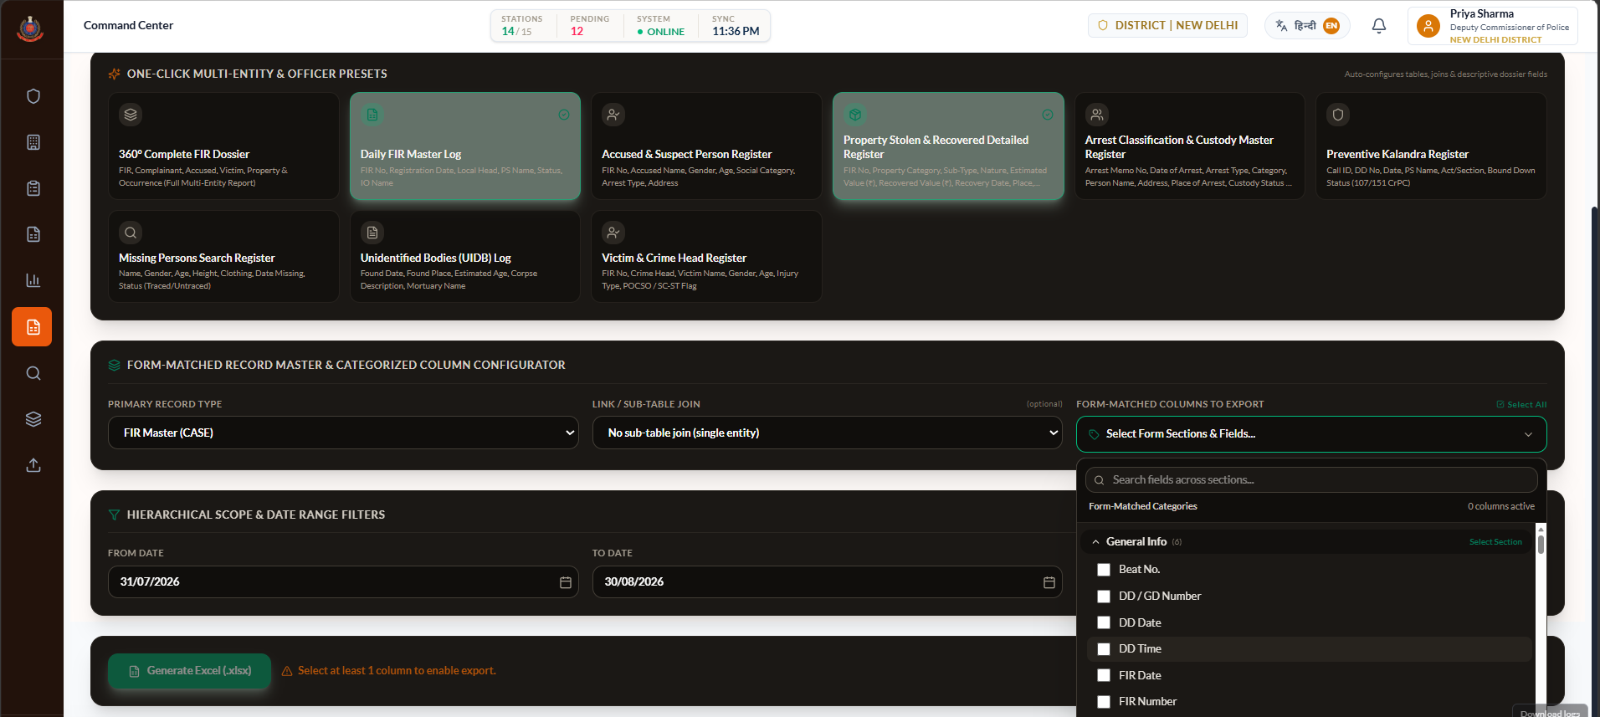

Slide 24
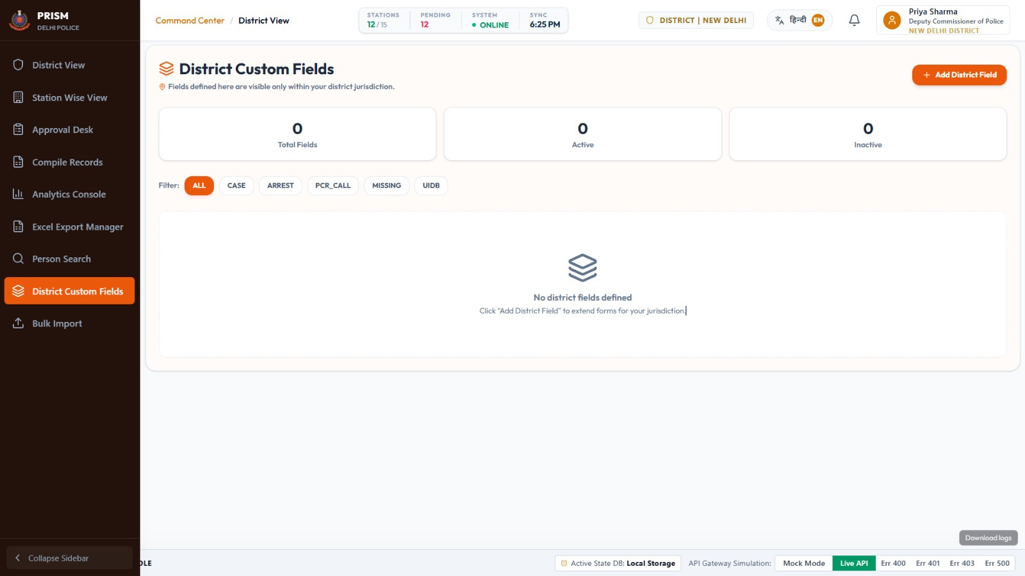
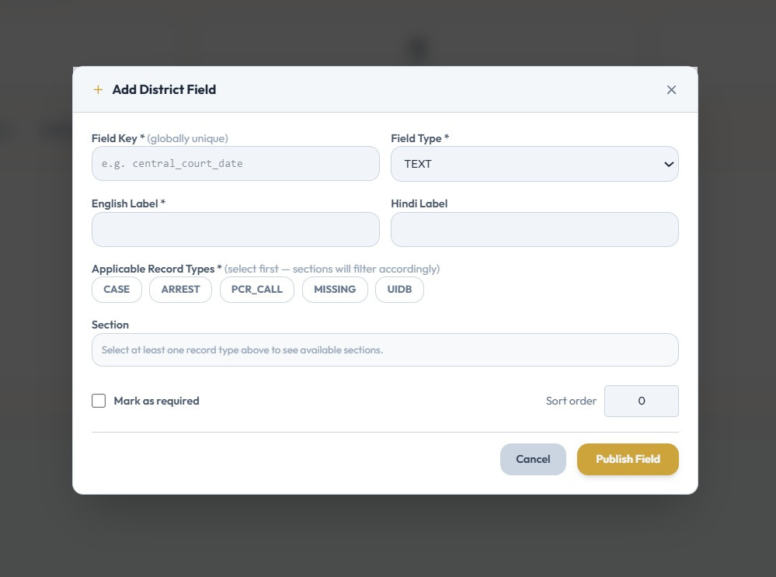

Slide 25
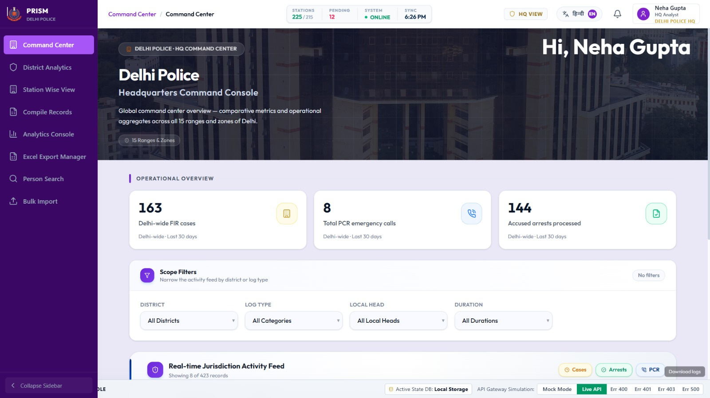
HQ RESEARCH CELL

Slide 26
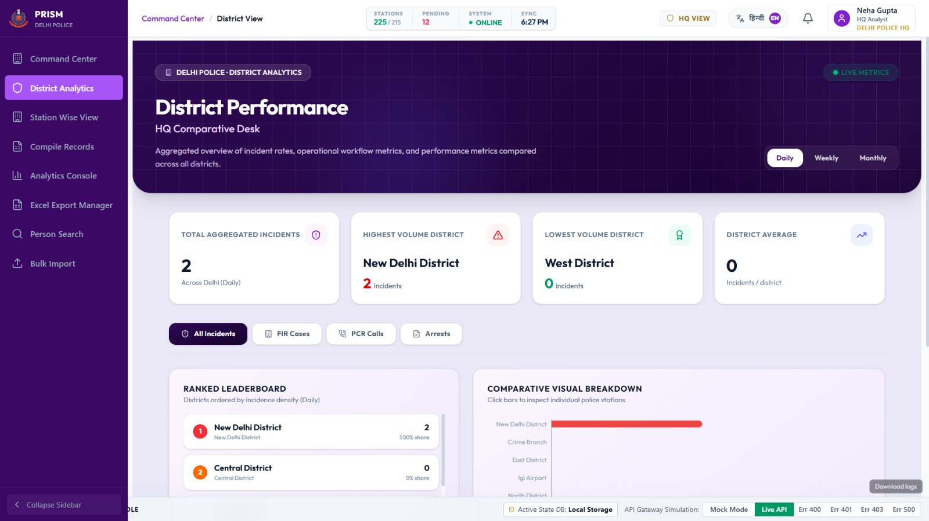

Slide 27
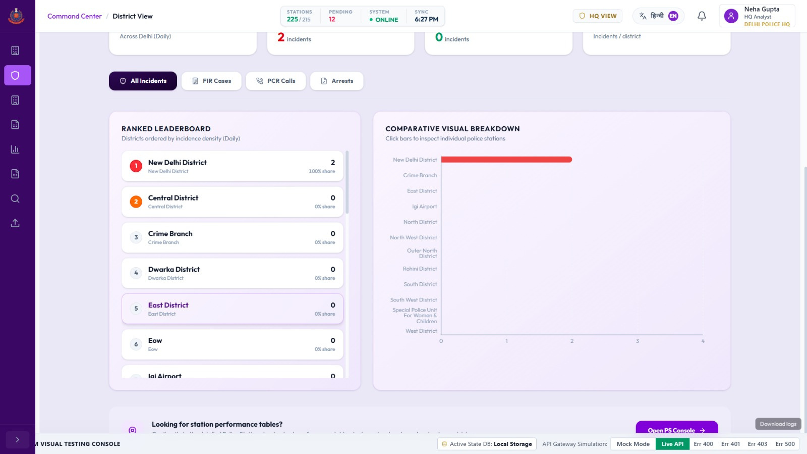

Slide 28
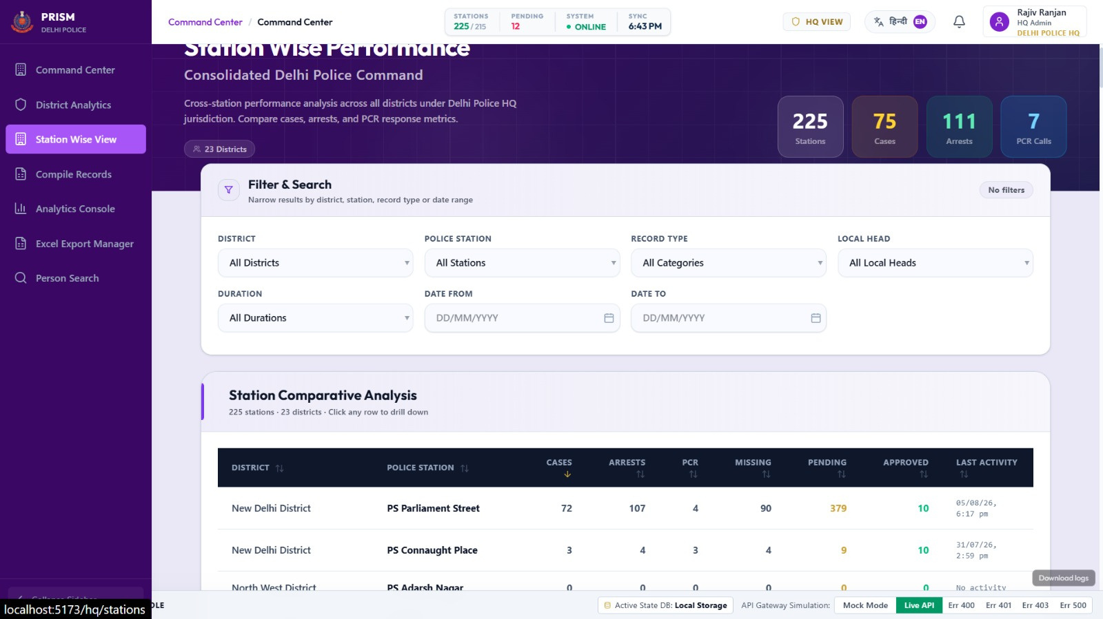

Slide 29
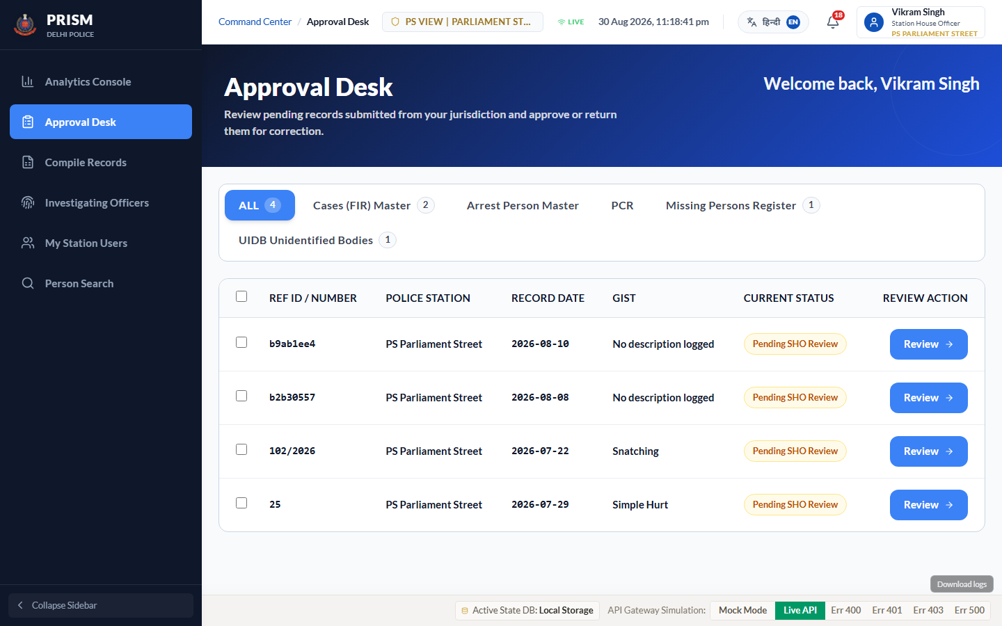
SHO REVIEW & APPROVAL QUEUE
📌 Key Function: Station House Officers review, approve, or return draft FIRs, arrest memos, and PCR entries before official submission to higher headquarters.

Slide 30
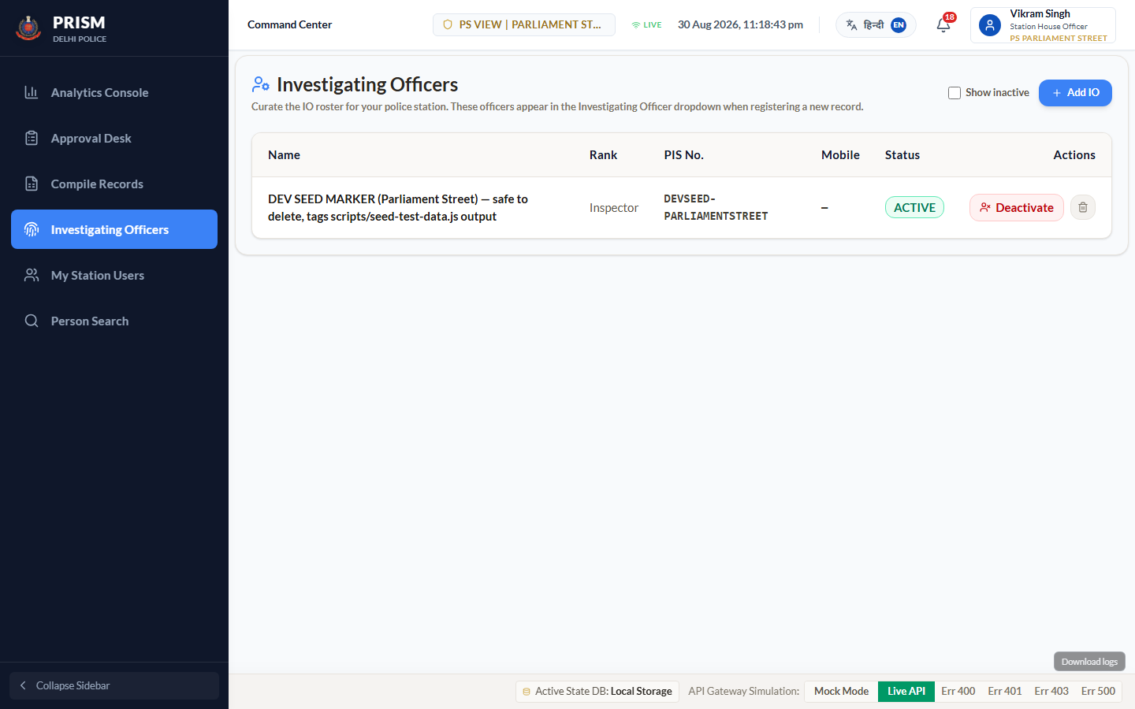
IO WORKLOAD & ASSIGNMENT MANAGEMENT
📌 Key Function: Station commanders monitor active case distribution across Investigating Officers (IOs), tracking pending disposals and workload balancing.

Slide 31
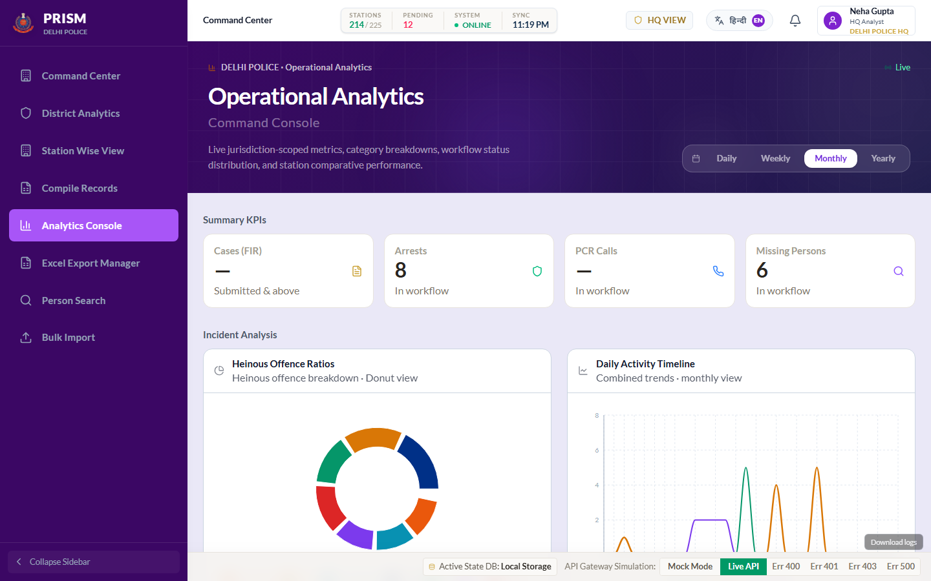
DATA WAREHOUSE OLAP EXECUTIVE ANALYTICS
📌 Key Function: High-performance OLAP dashboard providing real-time crime trend breakdowns, disposal rate analytics, and spatial district comparisons.

Slide 32
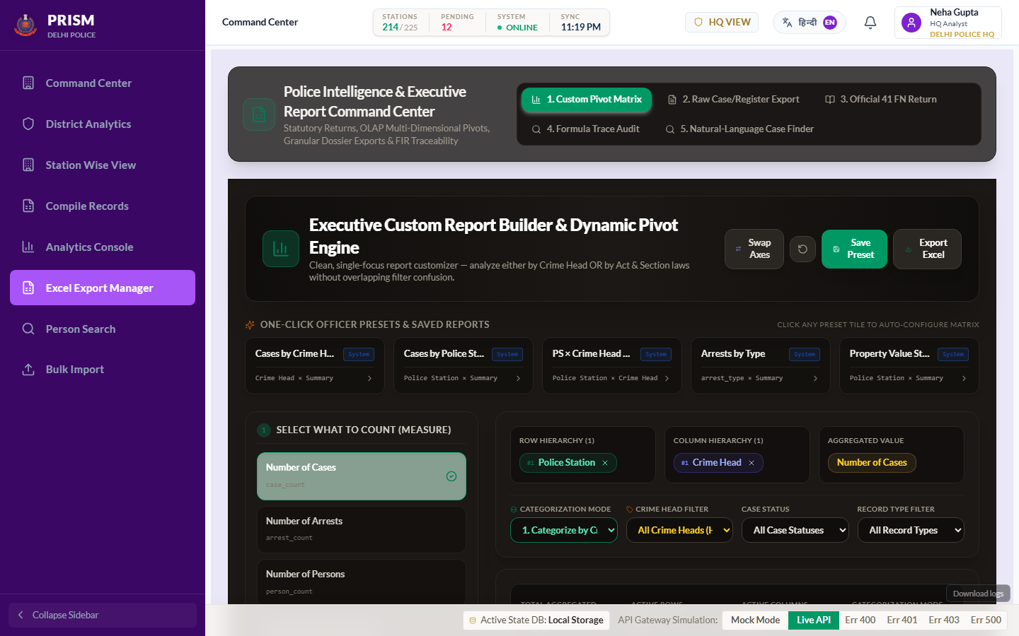
OLAP MULTI-DIMENSIONAL PIVOT MATRIX
📌 Key Function: Officers build ad-hoc cross-tabulations by dragging dimensions and measures into rows/columns/values, with live preview and one-click Excel export.

Slide 33
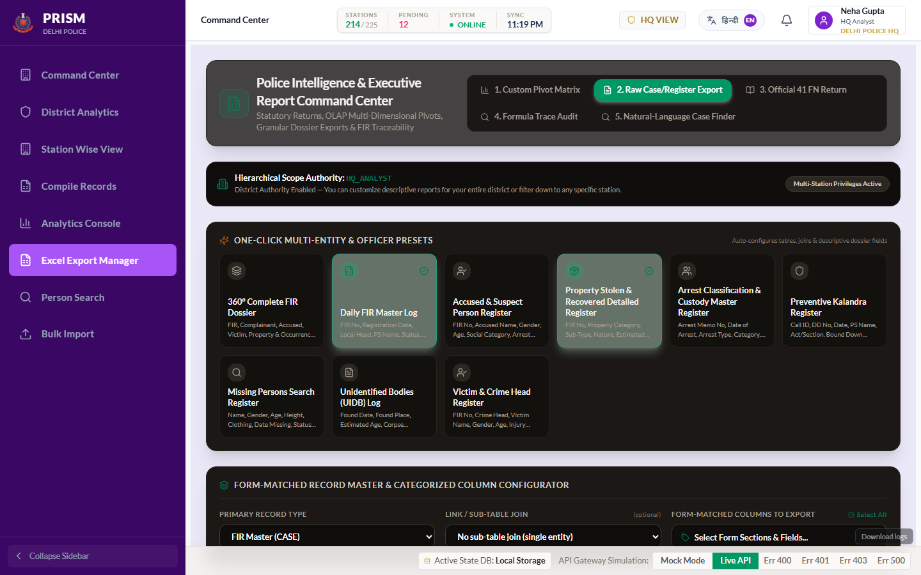
FORM-MATCHED REGISTER & RAW CASE CUSTOMIZER
📌 Key Function: Customizes raw FIR and register exports by selecting specific statutory form section fields, automatically formatted into section-aligned columns.

Slide 34
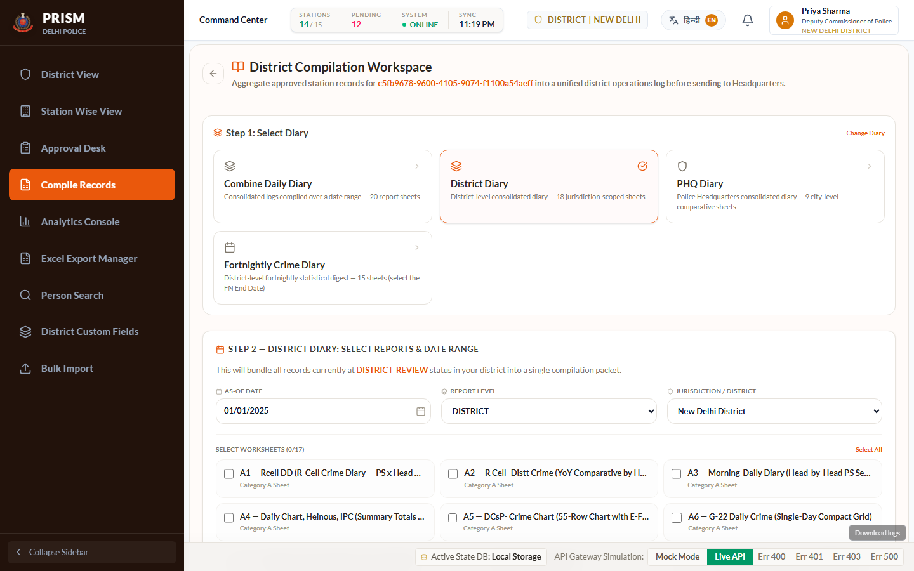
STATUTORY DIARY GENERATION & COMPILATION UI
📌 Key Function: Automates statutory return compiling for 41 FN Return, District Diary, PHQ Diary, and Daily Diary registers with formula verification.

Slide 35
THANK YOU
PRISM — Police Record Intelligence & System Management

